Slide 1


Slide 2
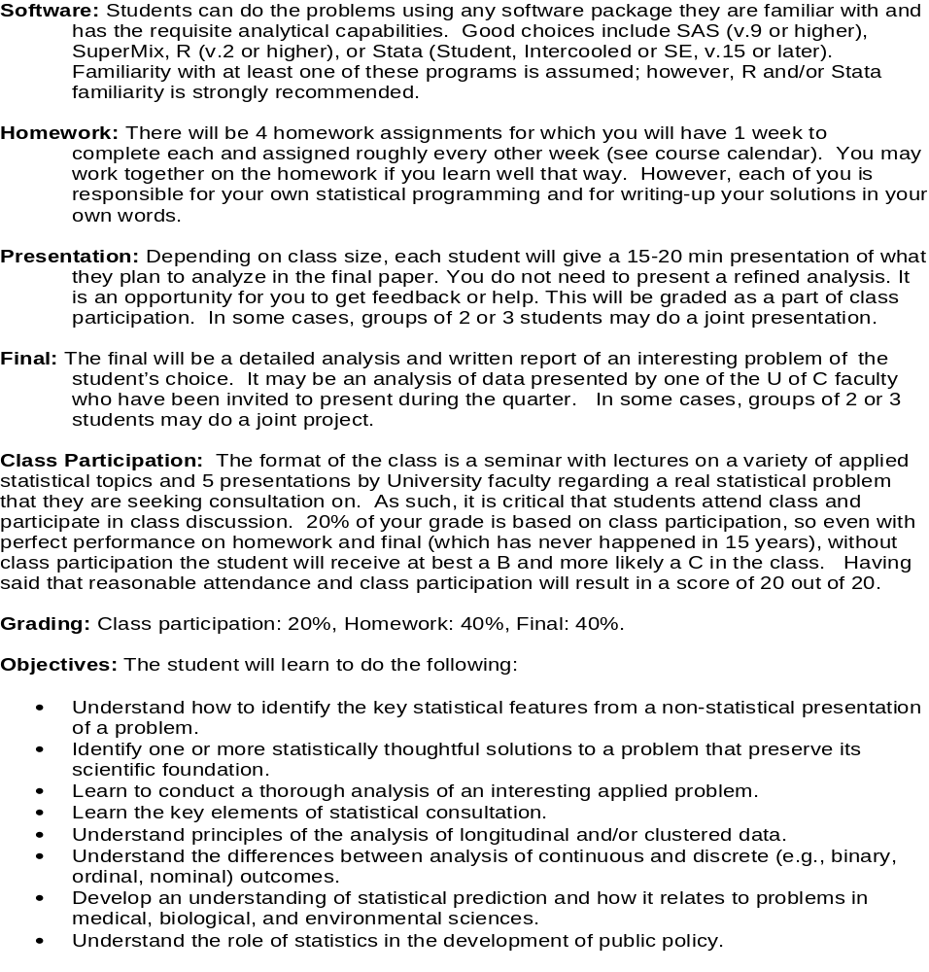

Slide 3
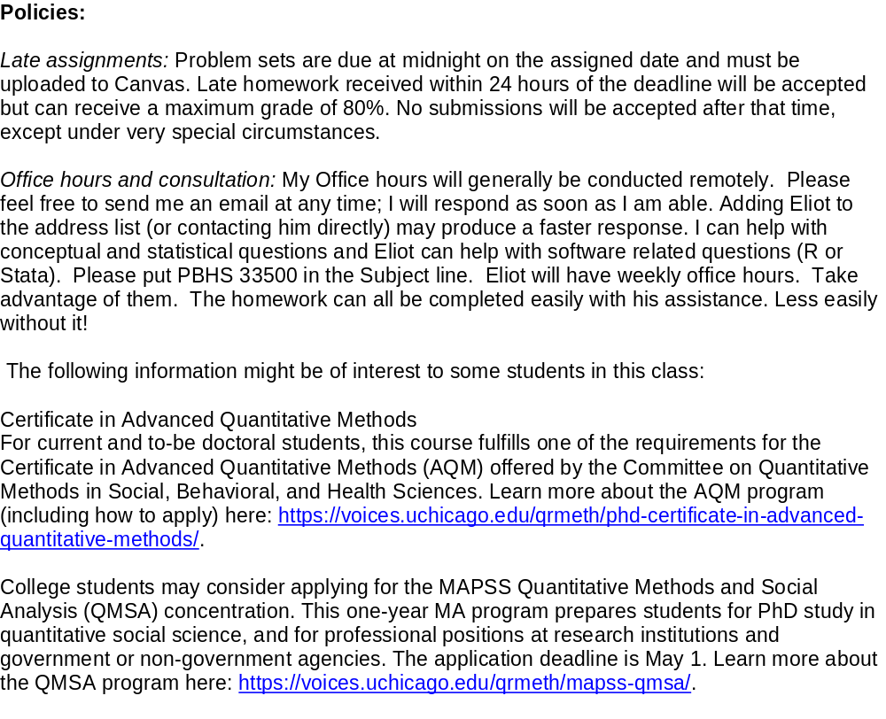
AI - ???????
Ask Questions!!!!

Slide 4
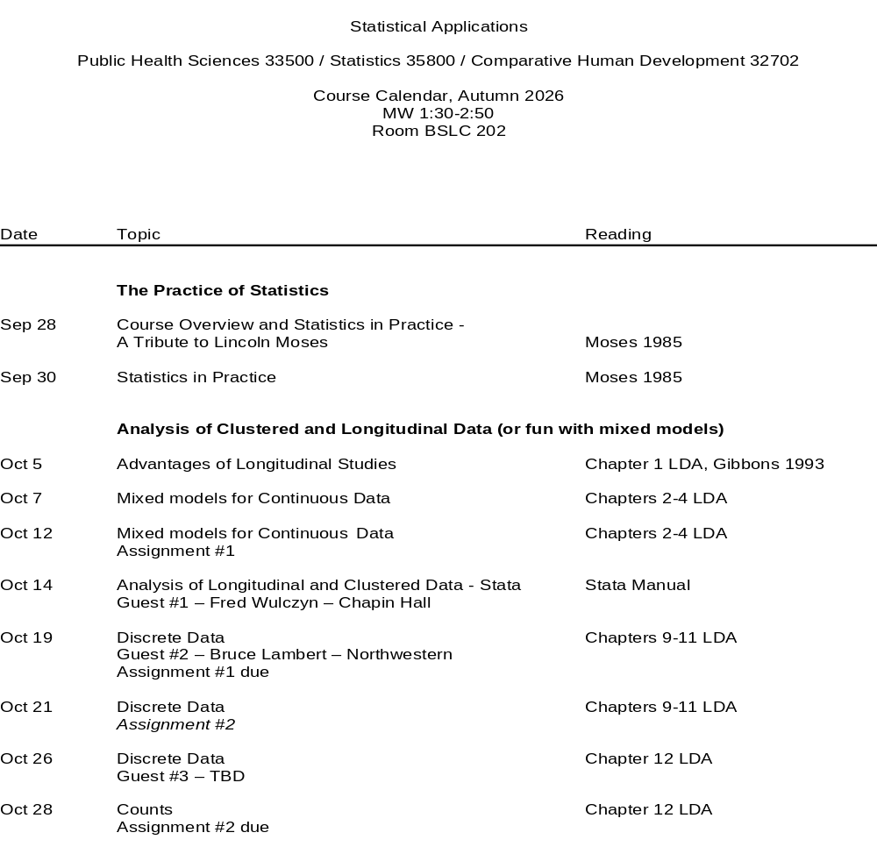

Slide 5
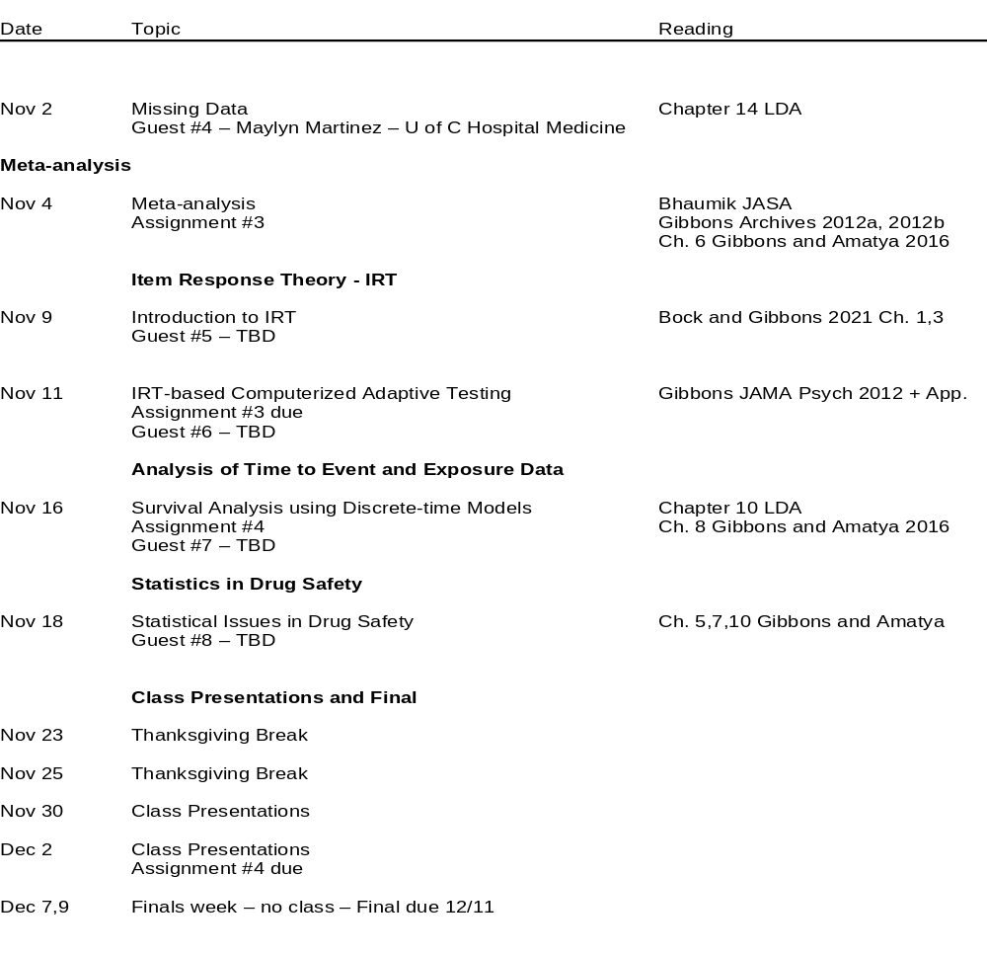

Slide 6
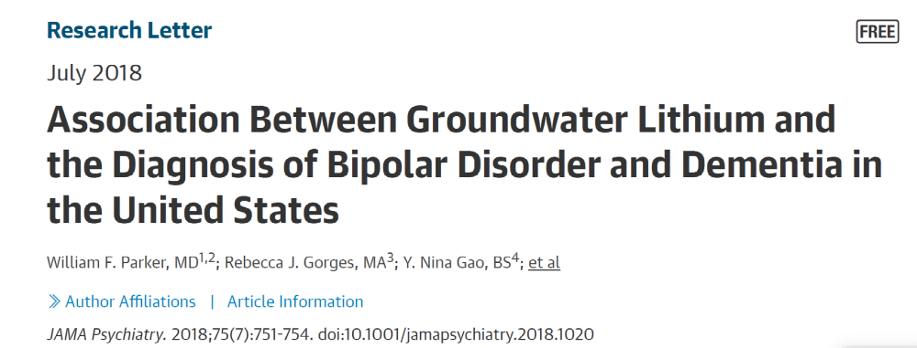
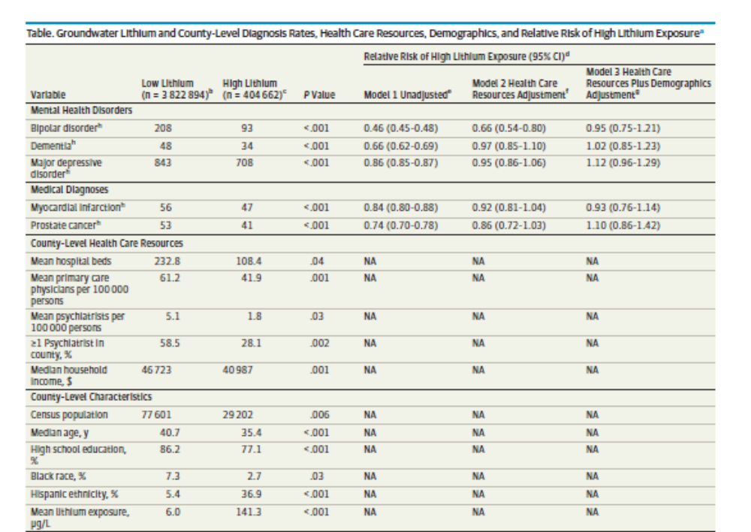
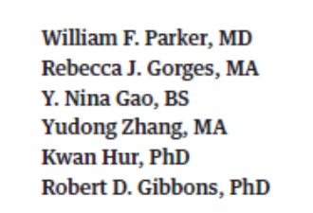


Slide 7
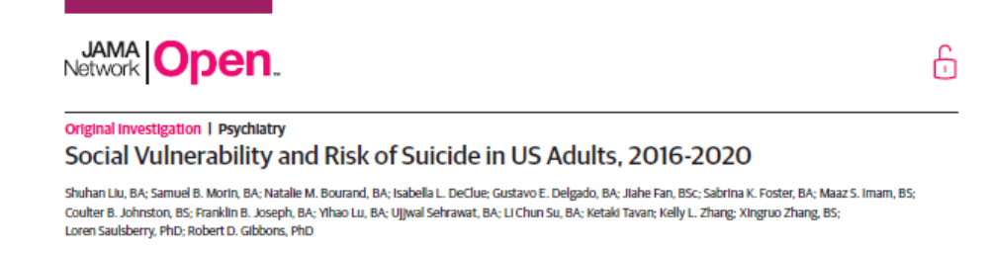
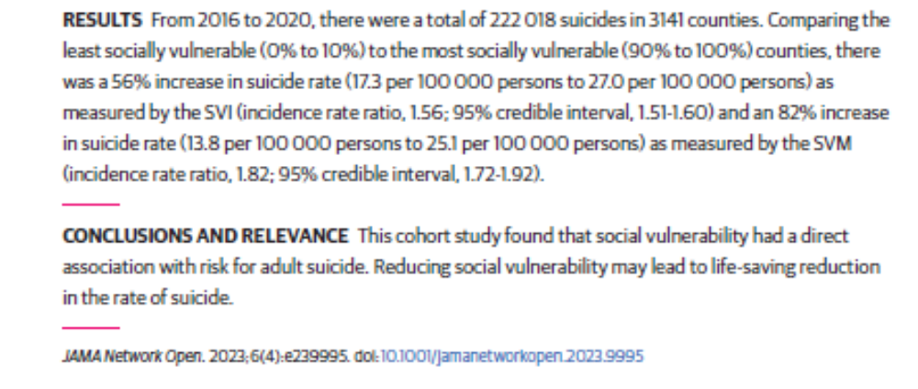

Slide 8
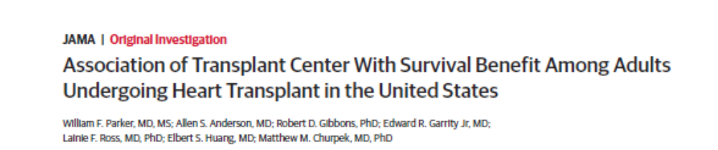
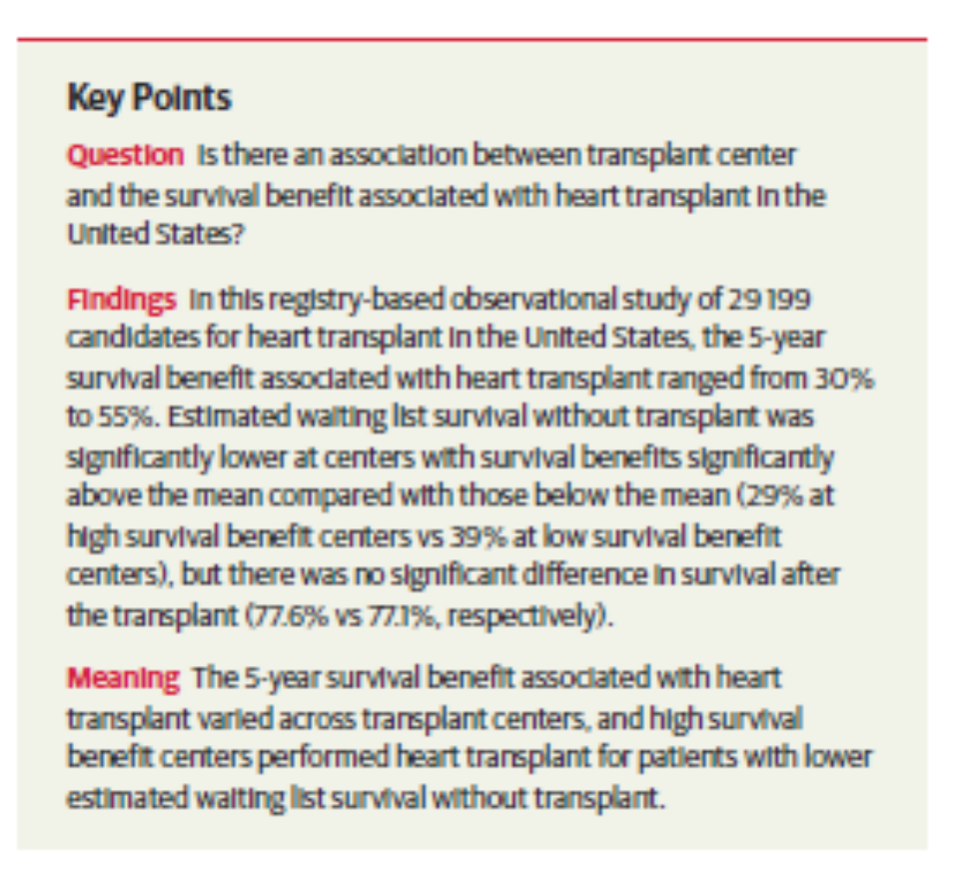

Slide 9


Slide 10

Quantitative Methods Workshop

Slide 11

Disclosure
Dr. Gibbons is a founder of Adaptive Testing Technologies, which distributes the CAT-MH® and K-CAT® battery of adaptive tests. The terms of this arrangement have been reviewed and approved by the University of Chicago in accordance with its conflict of interest policies. He has served as an expert witness for Merck, Pfizer, GlaxoSmithKline, AstraZeneca, and the US Department of Justice.

Slide 12

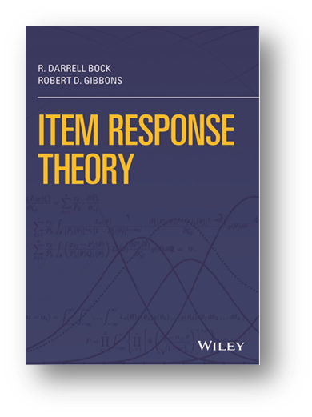
R. Darrell Bock, influential scholar of educational metrics, 1927–2021
A dedicated teacher, R. Darrell Bock was known for his influential work on item response theory, multinomial regression, marginal maximum likelihood, multivariate statistics and linear algebra.

Slide 13
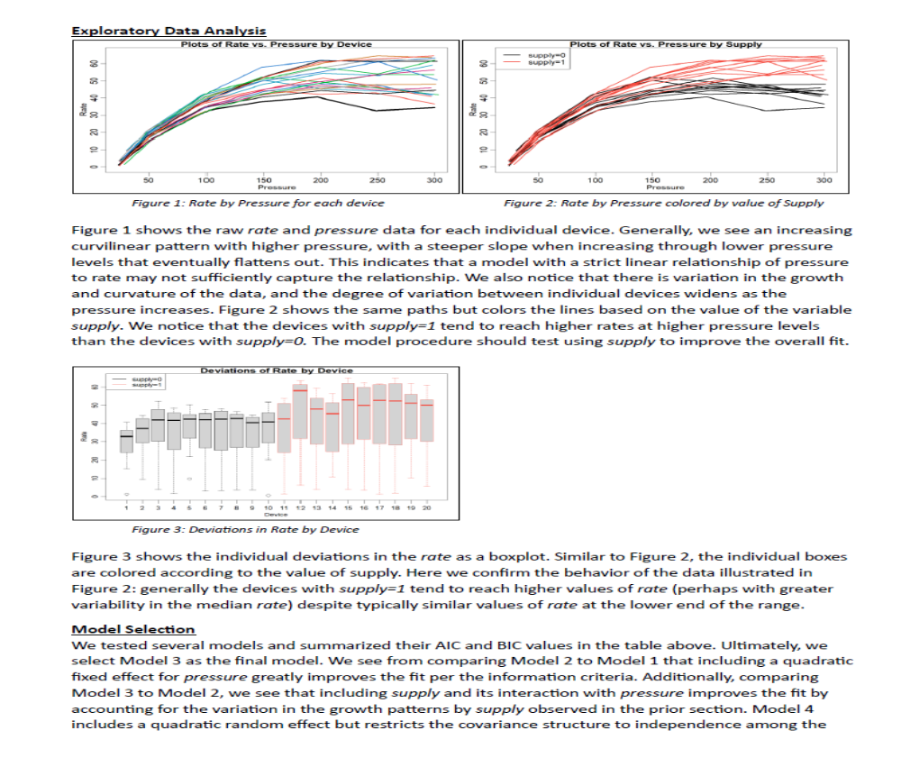
Example Homework

Slide 14
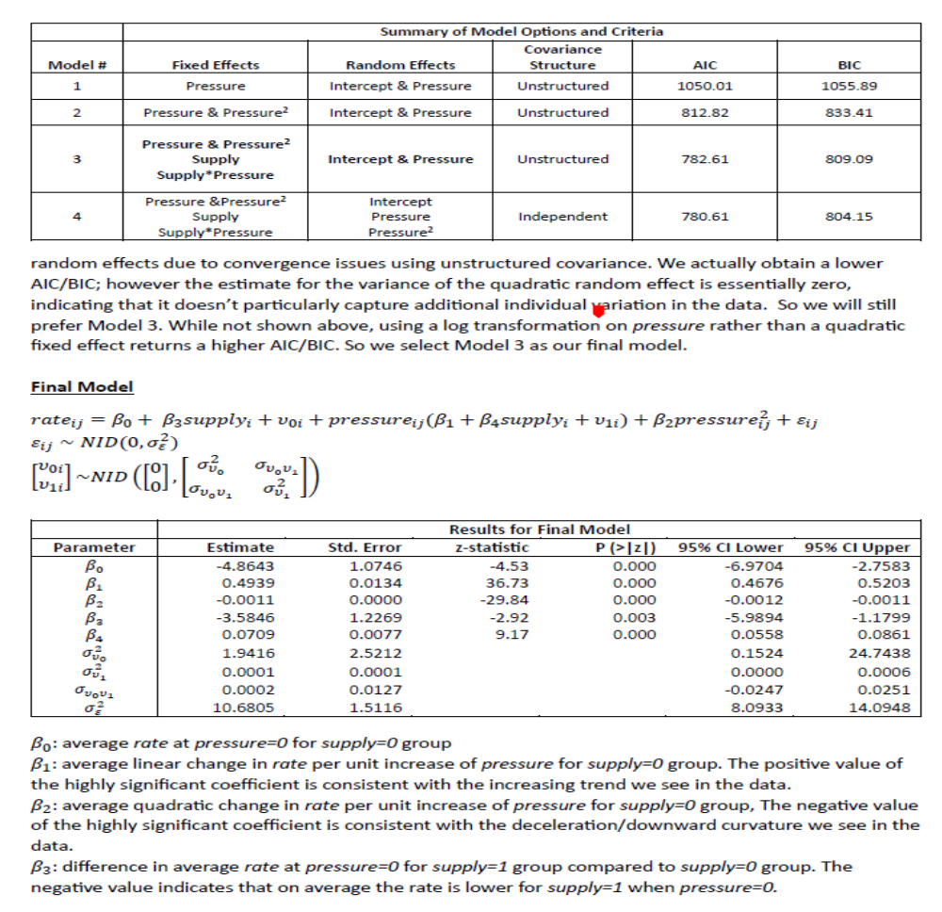

Slide 15
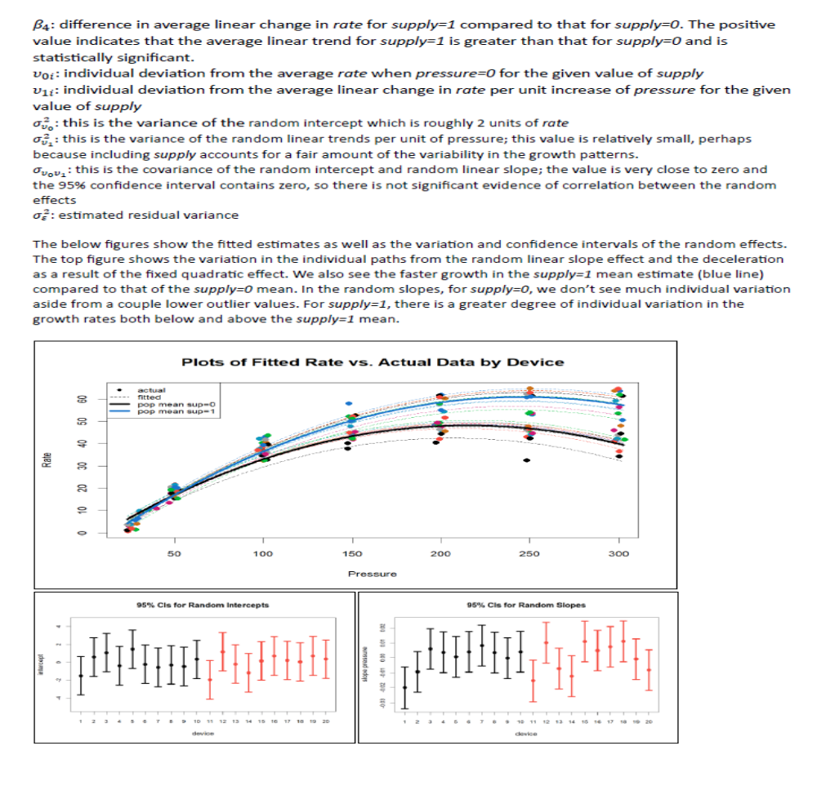

Slide 16
Lecture 1
Statistical Concepts Fundamental to Investigations
Or
How to select a great name for your kid

Slide 17
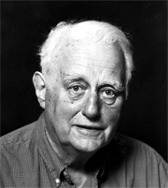
Lincoln E. Moses, PhD, professor emeritus died Dec. 17, 2006 at his home in Portola Valley. He was 84.
“Lincoln used to say, 'You have to have a good data-side manner,' and he had a wonderful data-side manner."
Department of Statistics and Department of Health Research and Policy.
Moved statistics from the realm of the academic to the applied
Founded the Division of Biostatistics.
Efron credited Moses with opening "a window on a different world of statistics for me and for many people, where you help people with their actual statistical problems, and he was remarkably good at that."
Although Moses had no medical background, "he could listen to somebody for half an hour and really understand what a person in the medical community was working on," Efron said.
"He was a wonderful teacher of how to consult."

Slide 18
I asked my advisor, Al Bowker, if he would approve my taking a minor in physiology.
He asked "Why?"
Moses: "Because I would like to apply statistical methods to medical research."
Bowker: "There is no place for statistics in medical research."
Moses: "Well if there is not, there will be."

Slide 19
"It's time for statisticians to focus some of their attention on policy matters."
Policy gets worked on and formed with frequent advice of lawyers and economists.
Statisticians should be present at the same undertaking and for very good reasons.
  The statistician is more evidence-based than average. He (she) is more likely to ask, "What are the data?"
  He's (she's) more likely to offer searching questions about the source and meaning of the data.
  How can we help equip our graduates for participation in policy consultation.”

Slide 20
"Of course, one should seek an approach which is valid, rather than easy, or gloriously complex. Among valid approaches, the simpler ones are generally easier to understand, easier to explain, and more likely to be convincing. Simplicity may also give considerable protection against gross bungling.
When asked "What is statistics?" I am likely to reply, "Statistics is a body of methods for learning from experience." As such, it is very important and, I believe, under appreciated.
Graduate training of statisticians should include both lots of mathematics and lots of contact with empirical problems-data from substantive fields like biology, psychology and economics.

Slide 21
Lincoln Moses - NEJM 1985
Statistics is a body of concepts and methods for learning from experience.
Statistical data represent counts or measurements from many separate instances showing individual variation.
Statistical inferences refer to interpreting quantitative data that are independent of the specific data at hand.

Slide 22
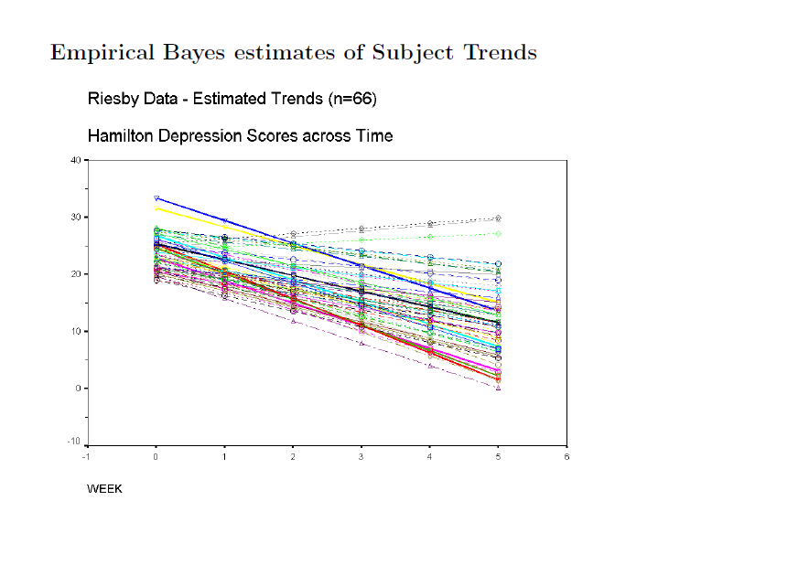
Individual Variation

Slide 23
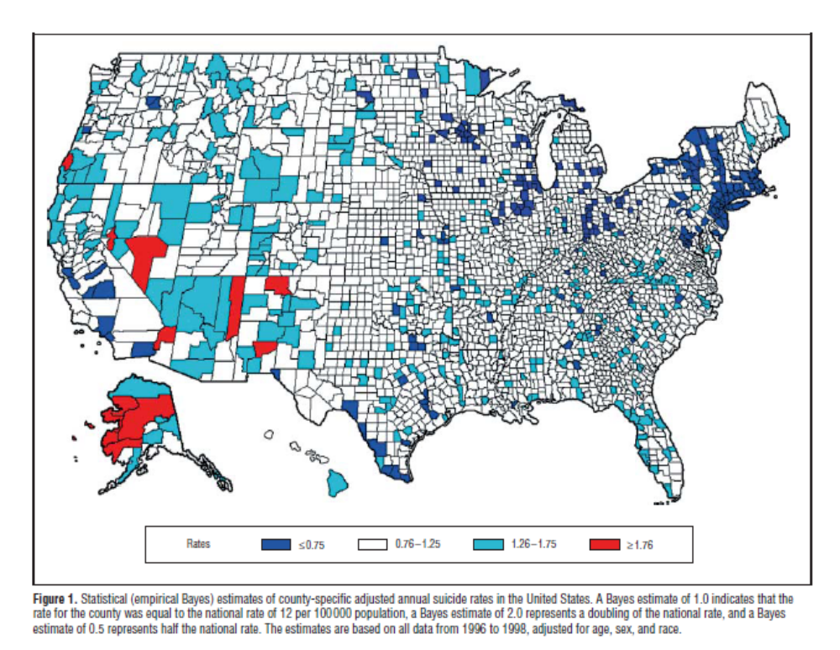
Ecological Variation

Slide 24
Definitions
Examples of statistical concepts are randomness, independence, and bias.
Examples of statistical methods are sampling, quality control, estimation of variances, and computing p-values.
Nearly all scientific investigations encounter statistical problems that demand solution.
Nearly all scientific literature raise statistical considerations.

Slide 25
Concepts
Operational Definition –
  To learn from experience, we must first state what experience is.
  Stage II disease can mean different things in different places.
  Suicide rates can mean different things in different jurisdictions depending on the coroner.
  A statistic reports the outcome of a measurement process, and we must understand the process to understand the statistic.

Slide 26
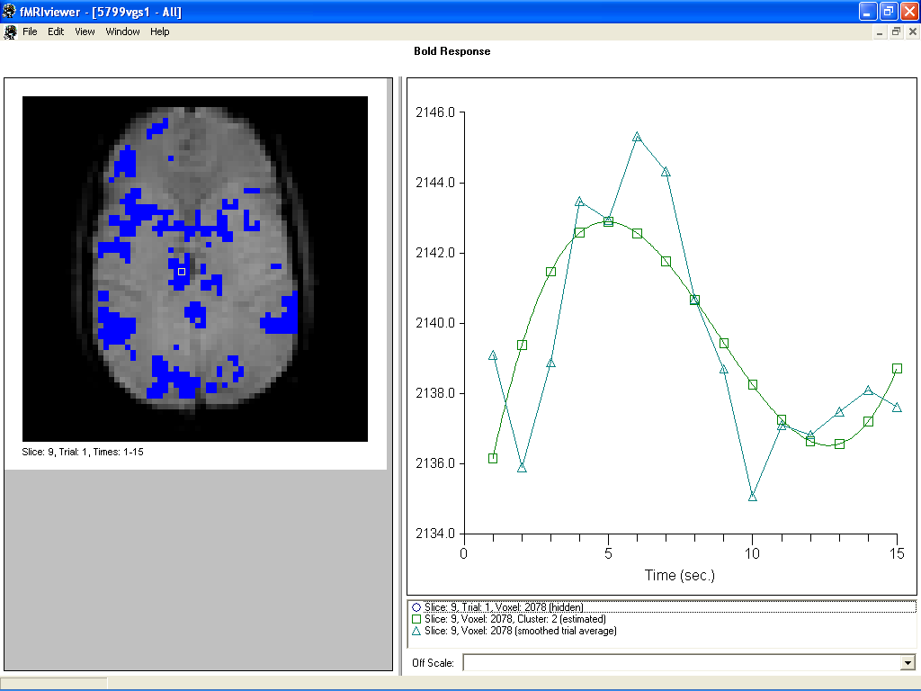
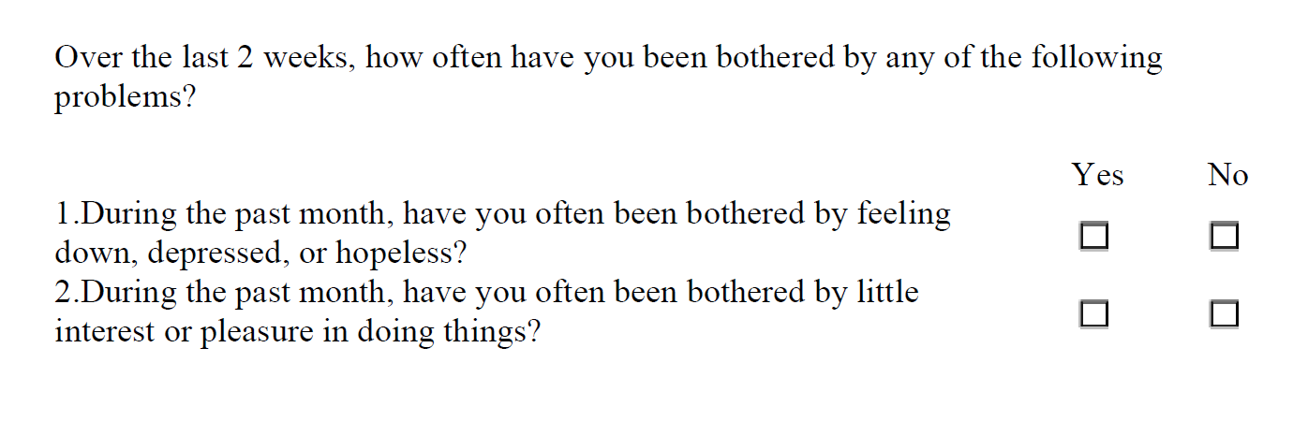
Medical Measurement
PHQ-2

Slide 27
Concepts
The Infinite-Data Case – “BIG DATA”
  Before considering a finite data problem (often small), what if we had a large amount of data?
  How would we analyze an infinite dataset?
  Would the infinite data analysis answer the questions we have?
  Could we change some aspect of the data gathering process to make the data more informative?

Slide 28


Slide 29
Concepts
Probabilistic Thinking
  A study produces a limited amount of data which in some ways approximates the infinite dataset.
  The closeness of the approximation depends on:
    The number of observations.
    Bias
    variability
  When the laws of probability govern the collection of data then statistical inferences have the force of logical consequences of these laws.

Slide 30
Quantity vs. Quality
We know that a 5% random sample is better than a 5% non-random sample in measurable ways (e.g., bias, predictive power).
But is an 80% non-random sample better than a 5% random sample in measurable terms? 90%? 95%? 99%?
Which one should we trust more: a survey with 60% response rate based on a probability sample or a non-probabilistic dataset covering 60% of the population?

Slide 31
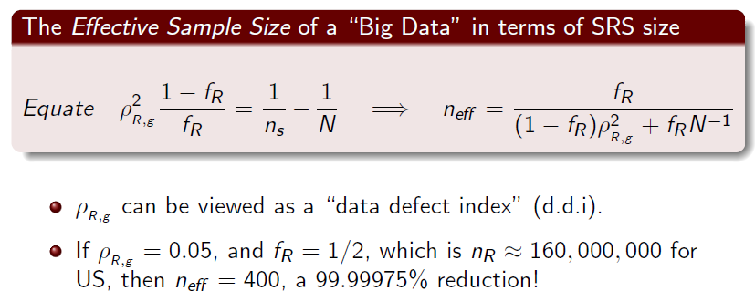
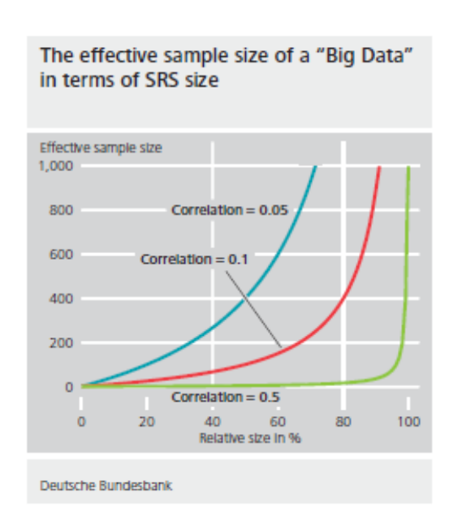
Quality vs. Quantity: A Stunning Result (Meng, 2015)
ρ is the correlation between the included value
x and the inclusion probability p(x)
What matters is the quality, not the size.
Watch the relative size, not the absolute size.

Slide 32
Concepts
Induction
  Statistical inference is a two-stage process.
    Stage 1 – How do these data reflect what we would have learned if we had infinite data?
    Stage 2 – If the data had been collected in a different way (e.g., in younger patients or community hospitals) would the resemblance to the infinite data change?
  Stage 1 is internal validity and Stage 2 is external validity. (RCTs vs. Observational Studies)
  Internal validity is largely a statistical matter.
  External validity requires substantive knowledge as well.

Slide 33
Concepts
Experimental Design
  Appropriate Statistical Design of a study helps prevent:
    Bias
    Improves efficiency
    Provides quality control for the data
    Aids in determining the required sample size

Slide 34
Operational Definition
Description of Terms
  Laboratory investigations describe detailed aspects of equipment, procedures, and materials to insure reproducibility.
  Clinical studies often do not.
  “Disease A, Stage II” sounds definitive, but aspects of the diagnosis, staging, who did the staging, reliability of the staging, blindness, repeat staging, all lead to variability and irreproducible results.

Slide 35
Operational Definition
  Measured characteristics present similar demands
    “Cardiac output” means one thing if done by angiography but may be quite different if done by blood gas analysis.
    How were the measurements made and were they done consistently for all subjects, centers, …
    Are different symptom rating scales exchangeable?
      Harmonization
  Treatments may not be what we think they are.
    An analgesic has both an active ingredient and an office visit that can help relieve a patient’s pain.
    Devising a proper control is critical. Enteromedics

Slide 36
The Infinite-Data Case
Appropriate Subjects
  What do AEs for healthy 25 year old med students tell us about AEs in 70 year old sick people?
Appropriate controls
  New method for dissolving clots in 1st 2 hours after heart attack.
  Experimental: Treat all patients with new method.
  Control: Standard care for patients arriving after 2 hrs.
  Is the new method better than the standard method?

Slide 37
Limitations of Associations
Observational studies even with infinite data do not prove causation.
  Intoxication from 3 types of alcohol mixed with water
  Antidepressants and suicide – confounding by indication

Slide 38
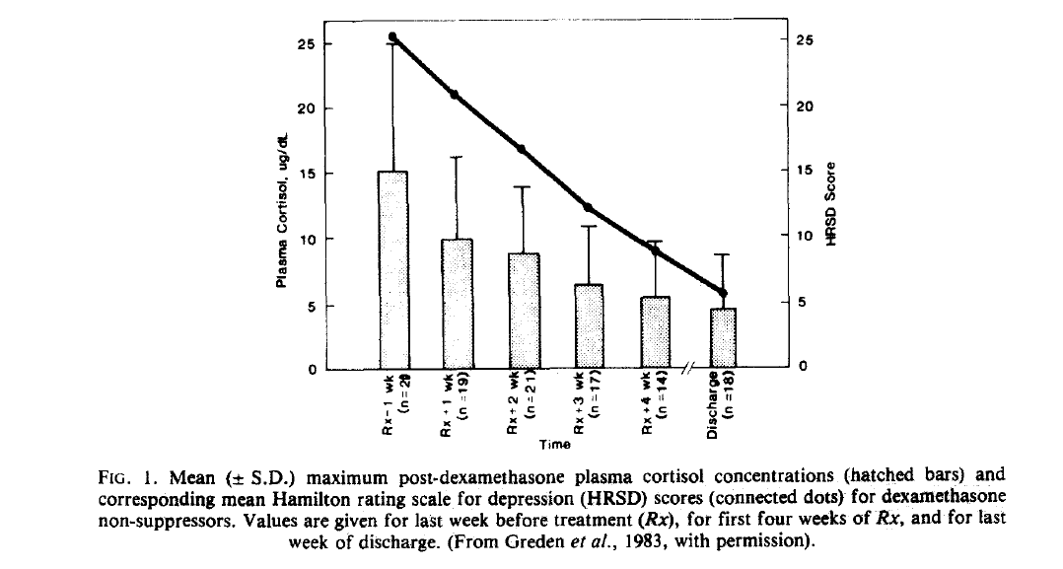

Slide 39
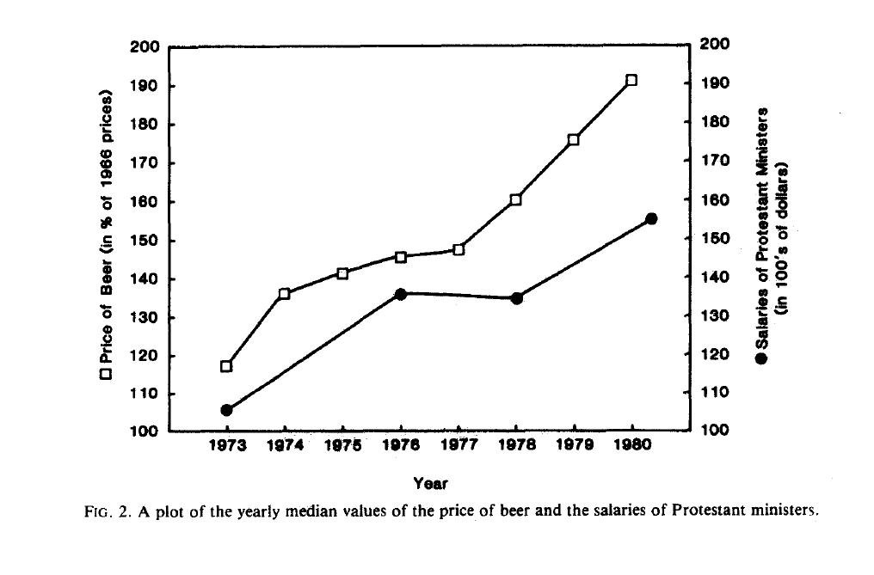
Gibbons R.D., Davis J.M. The price of beer and the salaries of priests: a note on the analysis and display of longitudinal psychiatric data. Archives of General Psychiatry, 41, 1183-1184, 1984.

Slide 40
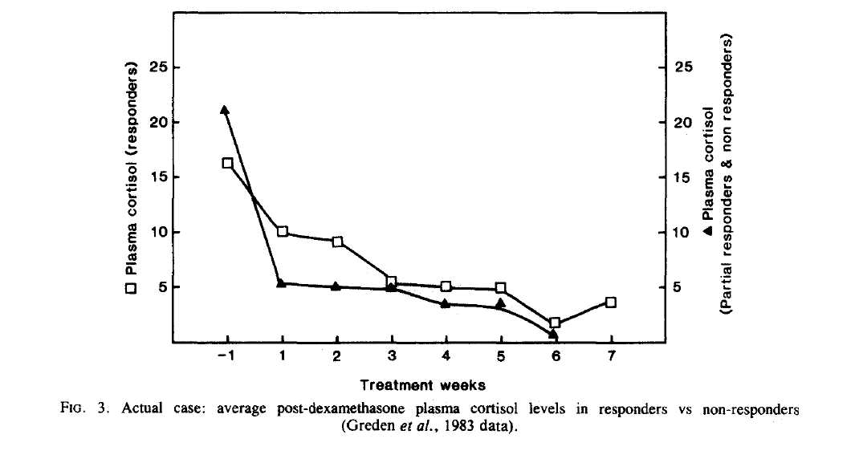

Slide 41
Limitations of Associations
Confounding
  Elapsed time since heart attack and method of therapy.
  Two variables are confounded if their separate effects cannot be identified.
  Personal choice or physician choice influences treatment and outcomes.
    Polio vaccine trials – n=2,000,000. Lower incidence in unvaccinated (parental refusal) than placebo.
    Differences between families that chose to participate and those that did not.

Slide 42
Limitations of Associations
Compliance effect
  Clofibrate and mortality
  Subjects who took 80% or more had lower mortality.
  Same for placebo
Adherence effect
  MTA study of the treatment of ADHD
  30% of behavioral switched to meds
  Those with prior meds did well
  Those without prior meds did poorly (non-responders)

Slide 43
Limitations of Associations
Ascertainment Bias – Even biases RCTs
  Drugs have more side effects than placebo.
  More side effects more time in clinic
    Clinic time may be efficacious
    Clinic time increases likelihood of reports of other AEs
  Suicide attempts by study drug overdose.
    OD on SSRI wake up in ER
    OD on Placebo wake up at home
    Result are more reports of suicide attempts on ADs
  The job of a statistician is not just to analyze data!

Slide 44
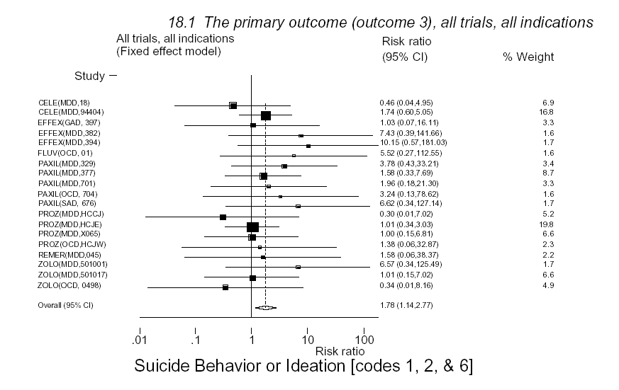
FDA
Hamad (2004, 2006) Meta-analysis
25 RCTs in kids – SSRI’s and SNRI’s
Retrospective chart reviews for “suicidal thinking and behavior”
Prospective measure of suicidal ideation
Ascertainment bias

Slide 45
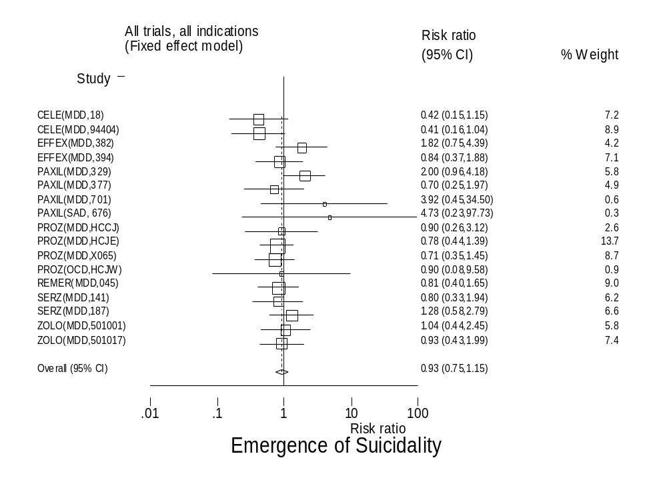

Slide 46
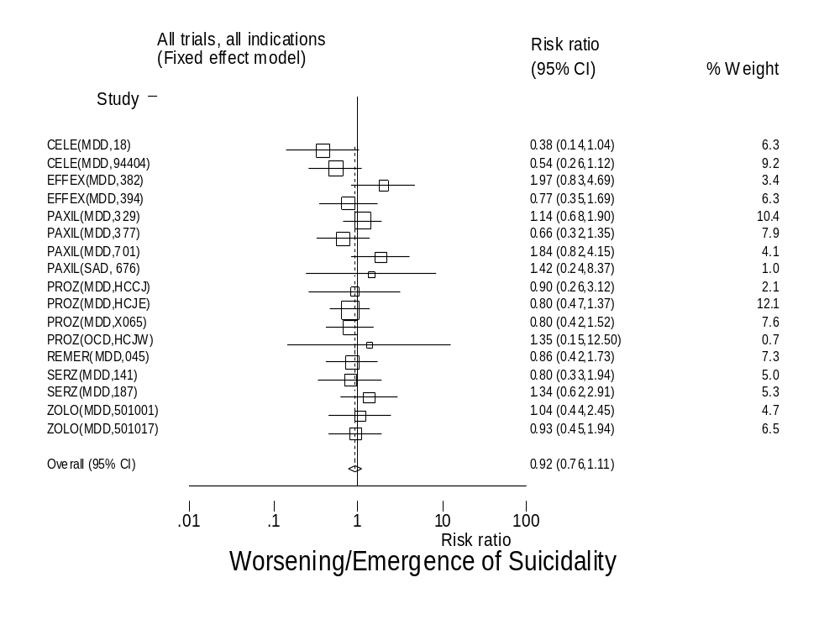

Slide 47
Limitations of Associations
Missing Data
  LOCF
  Completer Analyses
  Patients at end of study may not be representative of randomization.
  Be careful of GEE and other partial likelihood methods. They estimate the marginal means.
  For LOCF, if differential dropouts, Tx confounded with time.

Slide 48
Probabilistic Thinking
Sample Size (n)
  Differences between two or more random samples from a single population are smaller with larger n.
  Larger samples - less variability
  Increasing n by doubling enrollment period
    Harder to maintain quality control
    Change in personnel
    Shifts in patient population
  Independence – EPA 40CFR Part 264 CABF t-test

Slide 49
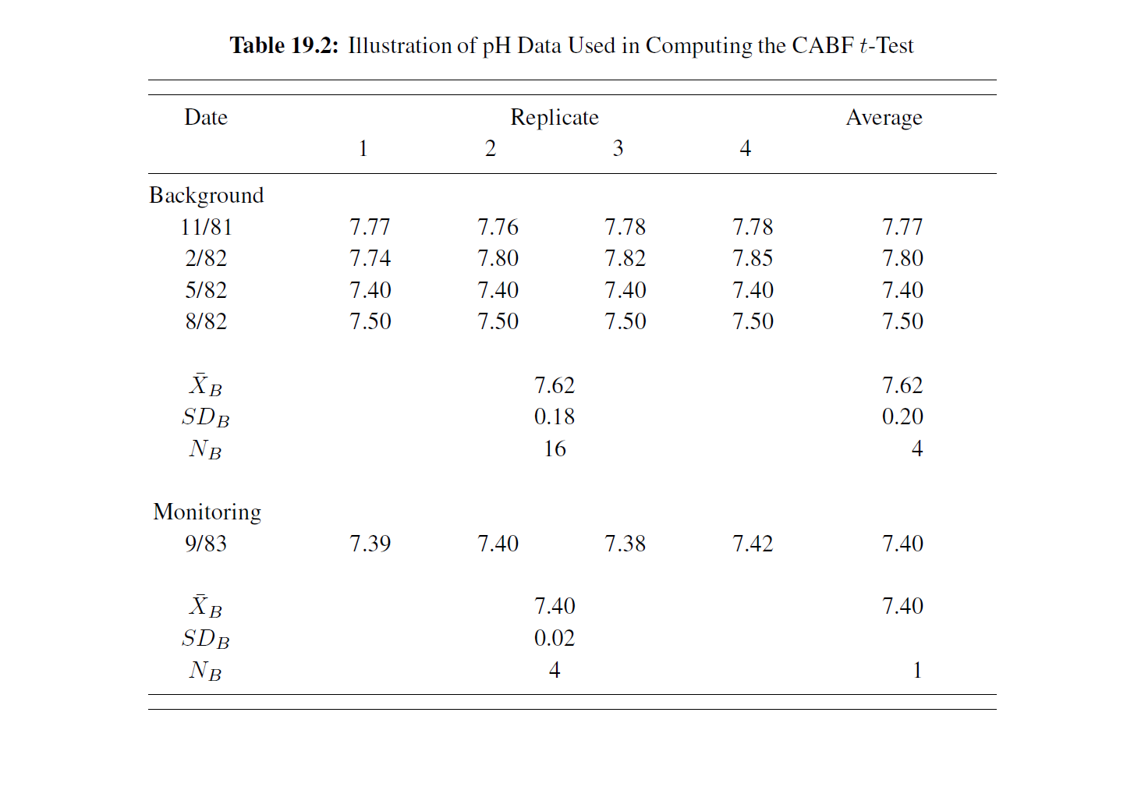
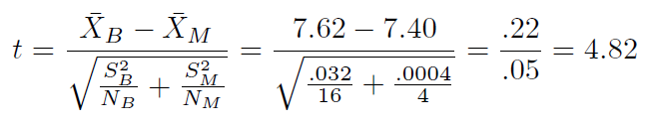
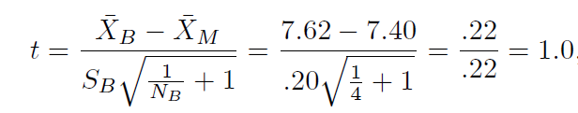
1 in 10,000
1 in 2

Slide 50
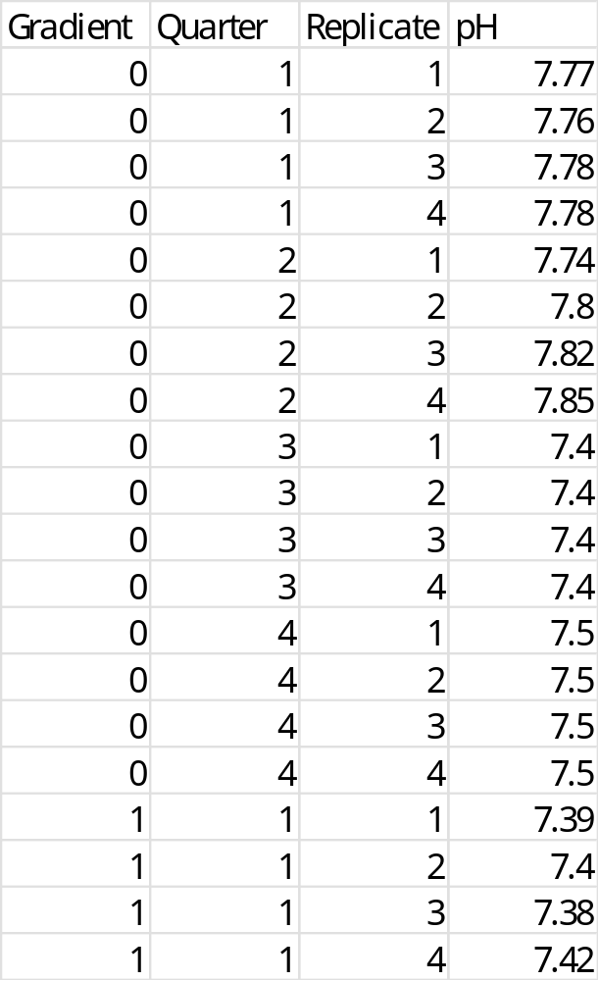

Slide 51
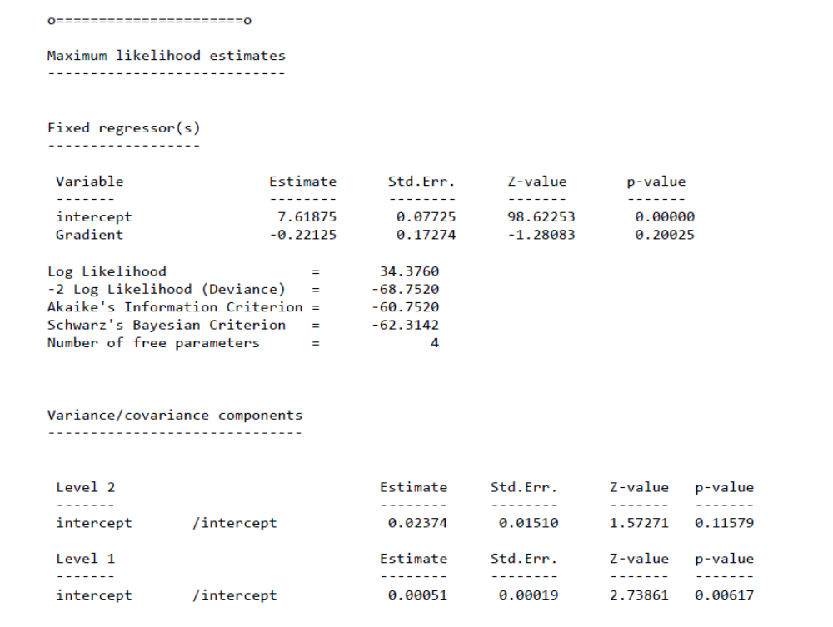

Slide 52
Probabilistic Thinking
Bias
  Difference in mean of intended infinite dataset and mean of the actual dataset.
  Increasing n does not decrease bias.
  Importance of controls – Cancels out bias.
  However, if different instruments or different raters in Tx and control, bias does not cancel.
  Bias enters through follow-up, staging, treatment, history taking, record keeping, and pt responses.
  Randomization and blindness are key
  Even randomization may not eliminate bias – ADRs

Slide 53
Induction
Induction is the philosopher’s problem that experience comes from one set of instances, and the learning is to be applied to other instances.
Probabilistic thinking helps to solve this problem.
Drawing a sample of n individuals from the population in a way in which every person has the same probability of being selected.
We can then make definite statements about characteristics of the population on the basis of the statistics computed from the random sample.

Slide 54
Induction
If two treatments have not been constructed as random subsets of eligible patients, we can still analyze the data, but the conclusions are not the logical consequences of the laws of probability.
“Statistical measures such as p-values and confidence limits no longer realize their nominal values of, say, 5 per cent or 95 per cent.”

Slide 55
Induction
Smoking and cancer
  7 key observational studies in 1954.
  Not until 1964 was it concluded that smoking conveyed a 10-fold increased risk for lung cancer.
Polio vaccine
  In 1954 randomized double-blind placebo-controlled study demonstrated protection of the vaccine.
  Immediately adopted.
  What was the effect size in terms of risk reduction?

Slide 56
Induction
National Children’s Study (NCS)
  Authorized by Congress (Children’s Health Act of 2000) large scale long-term study of US children and their parents.
  Study environmental influences on child health and development.
  Would have followed 100,000 children from before birth to age 21.
  NIH director (Francis Collins) convened an Advisory Committee to determine if the NCS was feasible.
  Study was never started, only a pilot study of 6,000 kids – Vanguard Study – launched in 2009 – cost 1.2 billion.

Slide 57
Induction
National Children’s Study (NCS)
  National Academy of Sciences (IOM) conducted a review of the study.
    Enormous potential but large number of challenges.
    Costs 1.5-3 billion to complete
    No protocol
    Sample pregnant women in hospitals with no list of hospitals available.
    Poor scientific leadership.
    Alternate designs possible.
  NIH Advisory Committee.
    NCS as designed is not feasible.
  Francis Collins cancelled the study in 2014.

Slide 58
Induction
So was cancelling the NCS a good idea?
  Focus on the alternate designs.
    RCTs
    Big Data – analyze EMR data linked to environmental exposures.
      Remember lithium in ground water and dementia and bipolar illness
  Failure to understand the importance of a national probability sample.
    Subsamples (males and females) are also random (probability) samples of male and female populations.
    Subsamples based on currently unknown risk factors are random probability samples.
    The purpose of a NPS is to ensure that every person has a non-zero probability of being included, so that sample matches the population on measurable and unmeasurable characteristics.

Slide 59
Induction
Why is this important?
  Environmental exposure X and health outcome Y
  Model as linear function Y=a+bX+e
  If all people in population have the same b, then it does not matter, as long as X is measured accurately, all we will have is random measurement error in Y.
  However, if there are confounding factors Z, which affect Y and are related to X, then our estimate of b may be biased unless Z is controlled.
  If Z is known we can use model-based adjustments assuming common support of Z on X

Slide 60
Induction
Why is this important?
  However, there may be moderator variables W that interact with X in influencing Y.
  Here different individuals will have different values of b depending on elements in W.
  If W is known, we can include interactions in our models so that estimates of b are unbiased overall or in defined subpopulations.
  Unfortunately in practice, W and Z are at least to some extent unknown, and may change over time. All we can get is an average estimate of b.
  The NPS produces unbiased estimates of average effects of b and within defined subgroups.

Slide 61
Induction
Platform for Scientific Discovery
  New exposures and gene-environment interactions
    NPS maximizes spread of W and Z in the sample.
  Maximize scientific acceptability
    Probability sample maximize potential for interdisciplinary collaboration
  Public and political/policy acceptance
    Until recently, scientific rigor led to greater acceptability of discoveries and resource allocation.
  Full variation in risks and exposures
    NPS produces generalizable risk estimates and policy/intervention benefits from discovered associations.

Slide 62
Confounding
Comparing Differently Treated Groups as Found
  New therapy in recent years vs. older therapy in earlier years.
  Operation 1 in Hosp. A vs. Operation 2 in Hosp. B
  To adjust we need to:
    Identify all “other” relevant variables
    Find the values of these variables in both samples
    Appropriately adjust for the potential confounders
    For example propensity score matching.

Slide 63
Smoking and Mortality
Nonsmokers Cigarettes Pipe and Cigar
% Mortality (1000 PY) 13.5 13.5 17.4
2 age strata 13.5 16.4 14.9
3 age strata 13.5 17.7 14.2
10 age strata 13.5 21.2 13.7
5-6 strata will eliminate 90% of bias
Stratification and statistical adjustment are very different things!
Identifies lack of common support (i.e., groups may not overlap on confounder)
Cochran (1968) Biometrics

Slide 64
More on Randomization
Comparing treatments in randomly assigned groups.
  Randomization enforces symmetry.
  It ensures that both subgroups have the same infinite-data case.
  If we exclude relevant variables:
    Randomization – standard errors increase
    Observational – bias + increased SEs
  Distributional balance is expected – need large n

Slide 65
Design
Improving efficiency
  Minimize variability
  Interfering variables
    Regression-based adjustments
    Assume common “support” i.e. overlap of X
  Sampling methods
    Compare treatments within similar subsets
      Twin studies
      Cross-over designs
      Propensity score matching
      Marginal Structural Models

